Slide 1
Emerging Technologies
Chapter Four
Internet of Things (IoT)

Slide 2
Outline
Overview of IoT
How Does It Work?
IoT Tools and Platforms
Applications of IoT

Slide 3
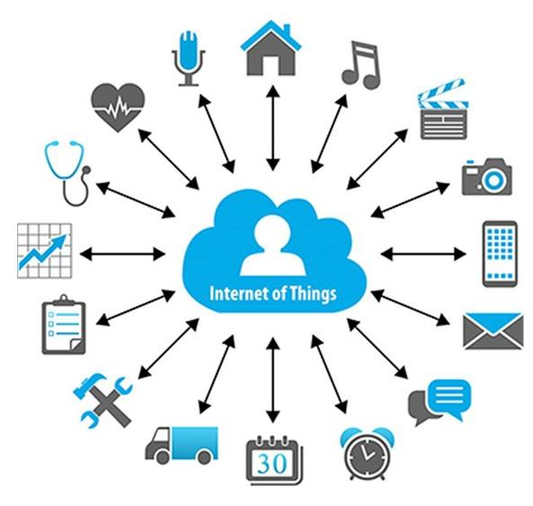
Learning outcomes
After completing this chapter, you should be able to:
Describe IoT
Explain how IoT works
Explain the architecture of IoT
Describe application areas of IoT
Describe the pros and cons of IoT
Describe IoT tools and platforms
Notes:
Things in this picture are connected to the Internet and to each other through an IoT network.
Extending the current Internet and providing connection and communication between and with everything.

Slide 4
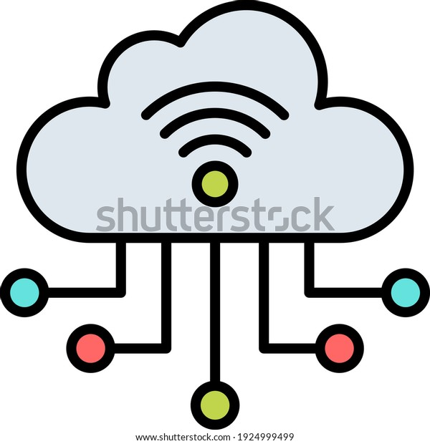
Internet of Things (IoT)
Extending the current Internet and providing connection, communication, and inter-networking between devices and physical objects, or "Things," is a growing trend that is often referred to as the Internet of Things.
“The technologies and solutions that enable integration of real world data and services into the current information networking technologies are often described under the umbrella term of the Internet of Things (IoT)”
Notes:
Data can be fed to AI services, for example, according to the second definition.
[Q] What is in communication? What do we mean by it?
The Internet of things describes the network of physical objects—a.k.a. "things"—that are embedded with sensors, software, and other technologies for the purpose of connecting and exchanging data with other devices and systems over the Internet. Wikipedia

Slide 5
Internet of Things (IoT)
Definition: Where Internet connectivity becomes expanded to everyday devices such as cars, home appliances, clothes, city infrastructure, and medical and healthcare devices.
One example of rapidly growing industry IoT: autonomous or driverless cars.
IoT devices cut across industries. Their interconnection forms systems typically described as “smart houses”, “smart cities”, and eventually “smart countries”.
Notes:
[Q] What does smart signify in IoT perspective or in general terms?
In the smart part is connectivity and seamless exchange and analysis of real-time data enabling to take immediate actions and to provide efficient services to users of the smart thing. In a way not experienced before or not experienced under normal circumstances.

Slide 6
Interplay between AI, Big Data and IoT
Key interplay between:
AI: Data-based learning
Big data: Capture, storage, analysis of large volume of data
IoT: Data collection (and processing) through network of things
Data collected by IoT sensors contributes to building large pools of data (Big data) which, in turn, can be processed and used for the development of ML and AI.
Connected devices in IoT generate Big data and we know Big data requires AI to be processed, and AI requires Big data for learning.
IoT = Data + Sensors + Networks + Services
Notes:
In the IoT equation, Services represent cloud computing (distributed computing), platform services, AI, management and other applications.
For example, data as a service can be provided by IoT through cloud services.
By management we mean: remotely monitoring, updating, and controlling things.
To be more specific, taking advantage of cutting-edge technologies like Machine Learning, Machine-to-Machine (M2M) Communication and Artificial Intelligence (AI), IoT aims at extending connectivity beyond standard Internet supported physical devices (smartphones, tablets, desktops, and laptops) to a wide spectrum of non-internet-enabled physical devices and everyday objects, such as coffee makers, washing machines, door locks, etc., so you can remotely monitor and control them with the help of a mobile or tablet device.

Slide 7
Things
Things are objects of the physical world (physical things) or of the information world (virtual world) which are capable of being identified and integrated into communication networks. Things have associated information, which can be static or dynamic.
Notes:
[Q] Can you identify the static and dynamic information that can be associated to things in IoT?
Static: Their Id, possibly their position (location) if fixed at one place.
Dynamic: Sensors data about their state or environment. Any changing characteristics that can be measured and sensed.

Slide 8
Things
Physical things exist in the physical world and are capable of being connected, identified, sensed, located, and actuated/controlled.
Virtual things exist in the information world and are capable of being stored, addressed, processed and accessed.
Notes:
Examples of physical things include things of the surrounding environment, industrial robots, goods and electrical equipment.
Examples of virtual things include multimedia content and application software.

Slide 9
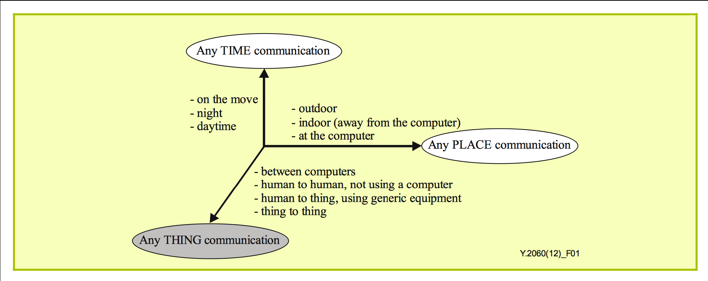
Any-Time/Place/Thing
Notes:
The vision underlying the Internet of things will allow information to be accessed "anytime“, "anywhere (anyplace)" from "anything".
This will be facilitated by using WSNs and RFID tags.
Any time, any place (or any where), anything communications is one of the characteristics of IoT.

Slide 10
Why should you learn about IoT?
Emerging technology
Growing IoT Services and Applications in various areas including smart cities, healthcare, transport, logistics, retail, safety and security, etc.
Business trends and new opportunities
Notes:
IoT is an emerging technology and possibly will affect everything and everyone.
Growing IoT Services and Applications and lots of opportunities.

Slide 11
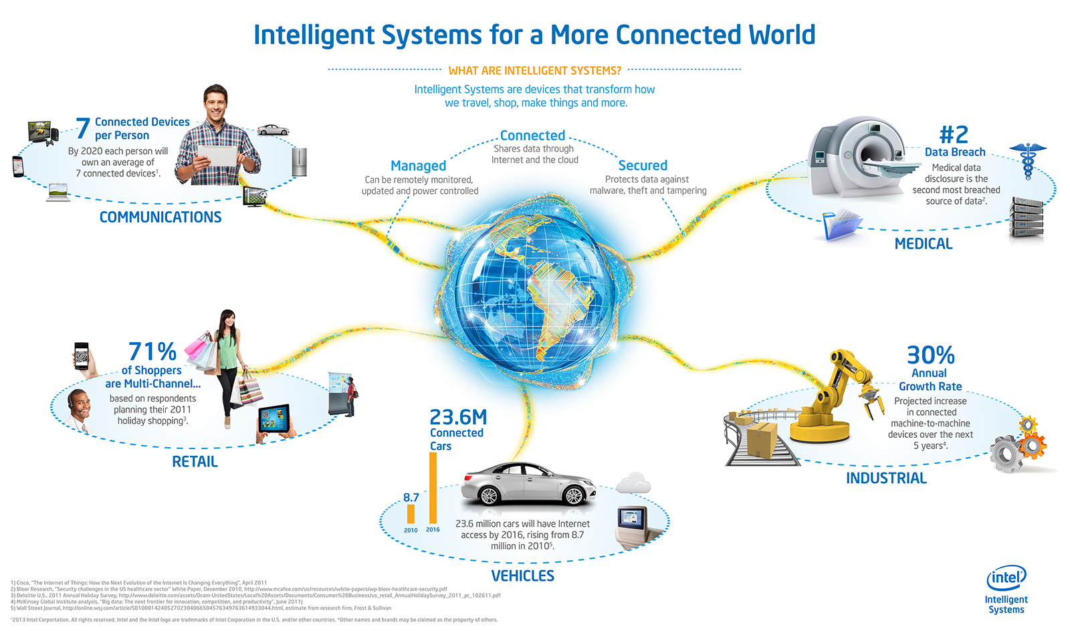
Opportunities & Challenges
Notes:
Intelligent systems are devices that transform how we travel, shop, make things and more.
A lot of growth in connectivity therefore lots of opportunities.

Slide 12
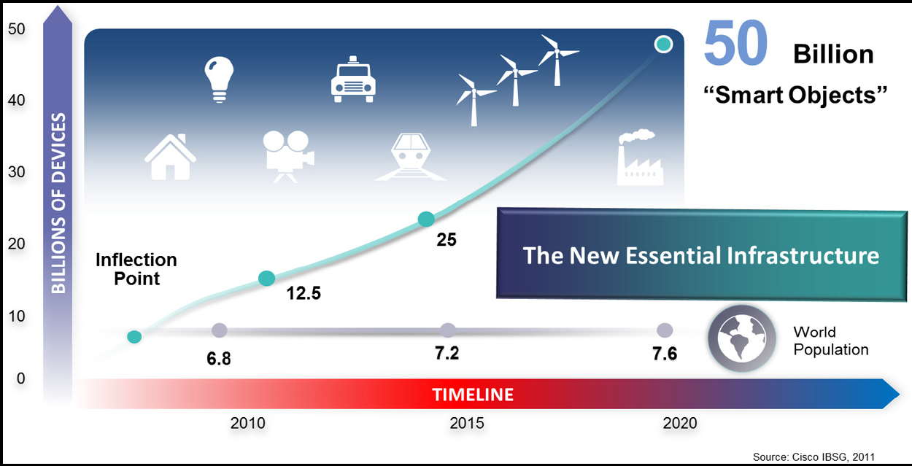
Internet-connected devices and the future evolution (Source: Cisco, 2011)
Notes:
The IoT is the new essential infrastructure.
IoT and Internet are not the same thing. Internet by itself is a world wide network infrastructure.

Slide 13
More IoT Definitions and Issues
A network of connected devices
1) With unique identifiers in the form of an IP address and other addressing and tracking techniques, and
2) Which have embedded technologies or are equipped with technologies that enable them to sense, gather data and communicate about the environment in which they reside and/or about themselves.
Notes:
How can devices be uniquely identified? How can devices or people be tracked?
Through IP addresses and RFID tags or hardware addresses.
A good example (common and practical) use of RFID is in car door locks and steering wheel locks.
[Q] What are the enablers or drivers of IoT?
IoT is being enabled or driven by miniaturization, wireless connectivity technologies, and increased data storage and processing capabilities. And due to many more other reasons . . .

Slide 14
Definition of IoT as a foundation and enabler
IoT is an umbrella term which describes a multi-faceted foundation for a range of applications and goals which are enabled through the connection of items (devices, sensors, tagged beings), equipped with data capture and communication capabilities, uniquely identifiable and connectable, in order to transmit and/or receive data for a clear human, business or societal purpose.
Notes:
[Q] How can a computer be uniquely identified in a LAN from a different network in the internet?

Slide 15
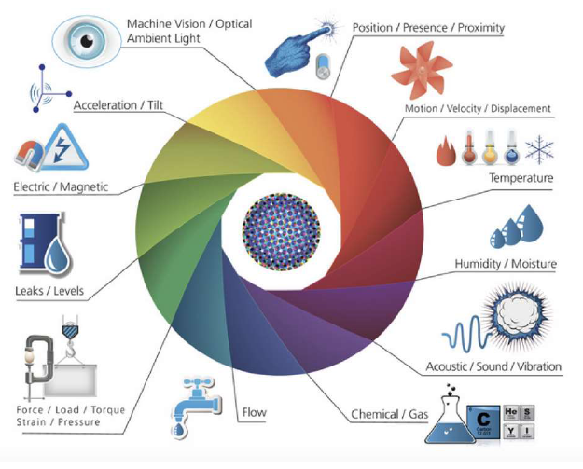
What is to be sensed in IoT?

Slide 16
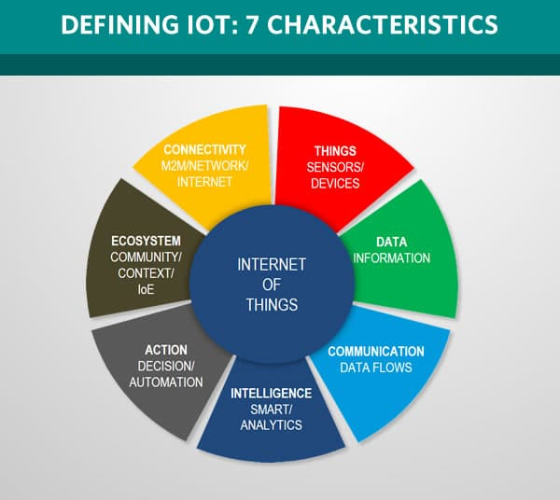
Notes:
Let us define IoT with 7 characteristics.
Defining IoT with 7 characteristics.

Slide 17
There are 7 crucial IoT characteristics:
1. Connectivity: With everything going on in IoT devices and hardware, with sensors and other electronics and connected hardware and control systems, there needs to be a connection between various levels.
2. Things: Anything that can be tagged or connected as such it’s designed to be connected. From sensors and household appliances to tagged livestock. Devices can contain sensors or sensing materials can be attached to devices and items.

Slide 18

Connectivity: WSN
A Wireless Sensor Network is a self-configuring network of small sensor nodes communicating among themselves using radio signals, and deployed in quantity to sense, monitor and understand the physical world.
Wireless Sensor nodes are called motes.
Notes:
Wireless Sensor Networks are built from numerous Wireless Sensor Nodes.
Mote: a tiny piece of a substance; a tiny spot; a small particle of a substance. Dictionary meaning.
Why WSN? WSN: Wireless Sensor Node and Wireless sensor networks.
WSNs are the building blocks of IoT. Like LANs are the building blocks of the Internet.

Slide 19
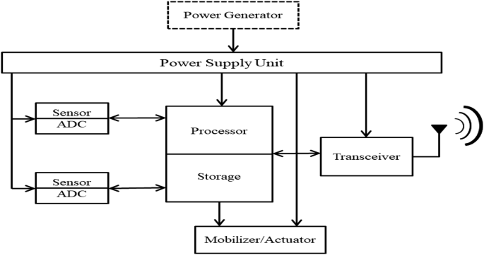
Connectivity: Mote Anatomy
Notes:
The Internal Organization of a Wireless Sensor Node.
[Q] What is the need for ADC?
[Q] What is a Transceiver?
[Q] What about unique identification? We need to tag it with RFID or . . .
To drive an actuator we may need DAC.

Slide 20
Mote (WSNode) Anatomy
Processor in various modes (sleep, idle, active)
Power source (AA or Coin batteries, Solar Panels)
Memory used for the program code and for in-memory buffering
Radio used for transmitting the acquired data to some storage site, and also the other way
Sensors for temperature, humidity, light, etc.
Notes:
[Q] What is the meaning or advantage of the processor being in different modes?
The processor need not to be active all the time. Why?
Most of the time in sleep mode, controlled by a piece of code in memory or remotely controlled.
When processor is in sleep or idle mode, that is the case most of the time, battery power is saved.
WSN devises are designed to collect data periodically. For example, once a day.
The device can be turned on and off and/or controlled remotely.

Slide 21
Connectivity: Mote Anatomy
These motes are highly constrained in terms of
Physical size, CPU power, Memory (few tens of kilobytes), Bandwidth (Maximum of 250 KB/s, lower rates the norm)
Power consumption is critical
If battery powered then energy efficiency is paramount
Batteries might have to last for years
May operate in harsh environments
Challenging physical environment (heat, dust, moisture, interference)
Notes:
[Q] Why are the wireless sensor nodes highly constrained in all the terms given above?
To make them very small, to make them use less energy, thus making them convenient to be deployed in large quantities.
To massively deploy them over large areas.

Slide 22
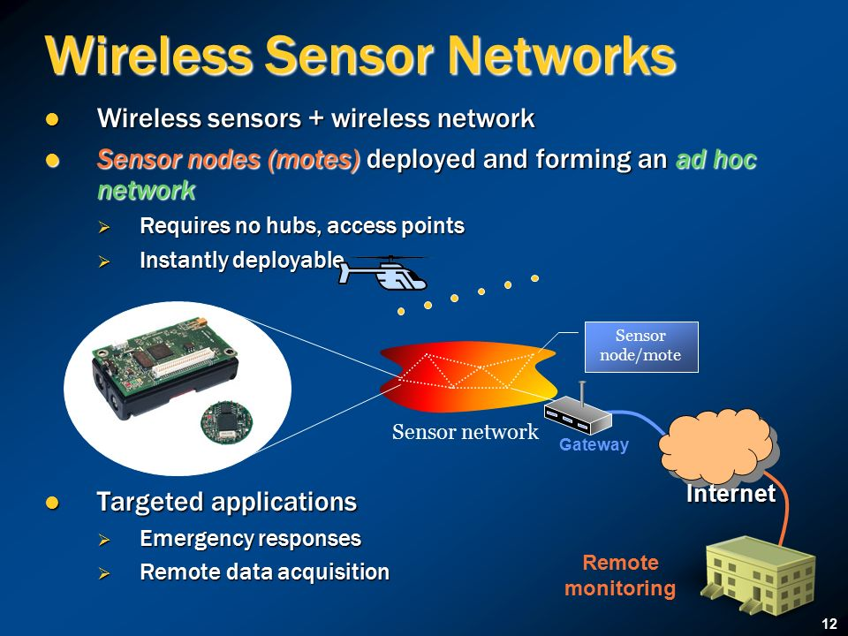
Notes:
Wireless sensor networks = Wireless sensor nodes + Wireless network protocol (software).
Wireless sensor networks may or may not require hubs, depending on the design or topology.
[Q] What is a gateway?

Slide 23
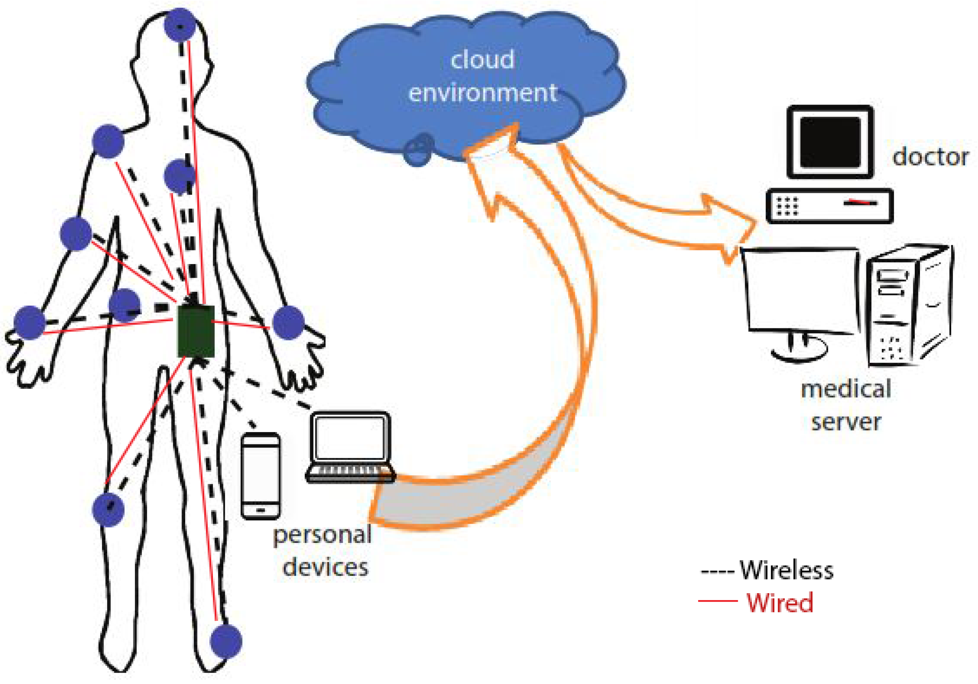
Body Sensor Networks

Slide 24
There are 7 crucial IoT characteristics:
3. Data. Data is the glue of the Internet of Things, the first step towards action and intelligence.
4. Communication. Devices get connected so they can communicate data and this data can be analyzed. Communication can occur over short distances or over a long range to very long range. Example protocols: Wi-Fi, & LoRa.
5. Intelligence. The aspect of intelligence as in the sensing capabilities in IoT devices and the intelligence gathered from big data analytics (also artificial intelligence).

Slide 25
There are 7 crucial IoT characteristics:
6. Action. The consequence of intelligence. This can be manual action, action based upon debates regarding phenomena (for instance in smart factory decisions) and automation, often the most important piece.
7. Ecosystem. The place of the Internet of Things from a perspective of other technologies, communities, goals and the picture in which the Internet of Things fits. The Internet of Everything dimension, the platform dimension and the need for solid partnerships.

Slide 26
Reading Assignment: The Following topics are left as a reading assignment for you.
History of IoT
Advantages, Disadvantages, and Challenges of IoT

Slide 27
The key components of an IoT deployment from a high-end perspective are:
The environment (sensing and data capture, in some cases analysis at the edge).
Connectivity within the endpoint environment where data from sensors and to actuators are transmitted, and received in hubs (or gateways).
Connection with the cloud and applications, in some cases middleware, called IoT platforms.
The actual outcomes in the form of the end customer application and/or process integration/automation and/or services.
Notes:
Analysis at the edge: Analysis of data at the gateways and within smart objects. What we call edge and/or fog computing.
What is the advantage of analysis (or processing) at the edge? Increased performance.
Edge or Fog computing.

Slide 28
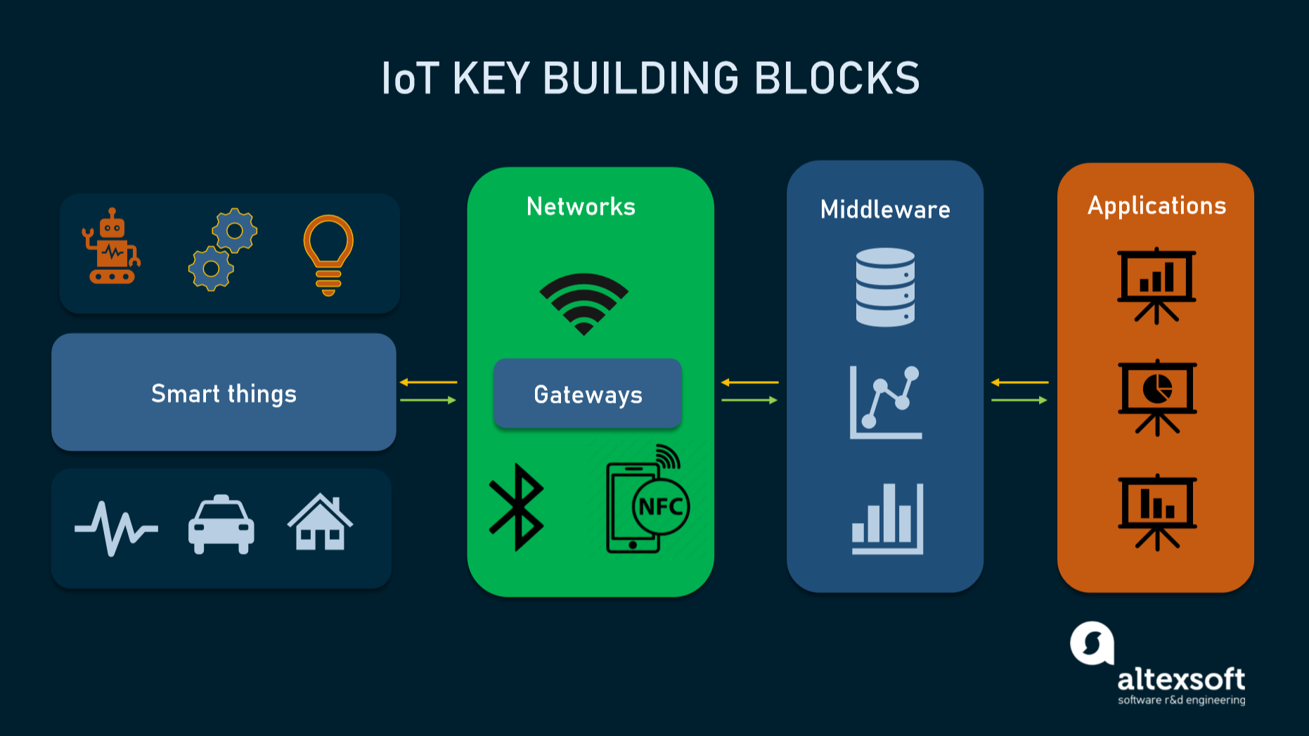
Notes:
Smart things are end points where sensors and actuators are located.
Smart things and networks represent the edge in this picture.
The middleware is where data analytics, AI, and many other services are residing.
Applications layer is where customers and end users are served with decision support information and control is sent from.

Slide 29
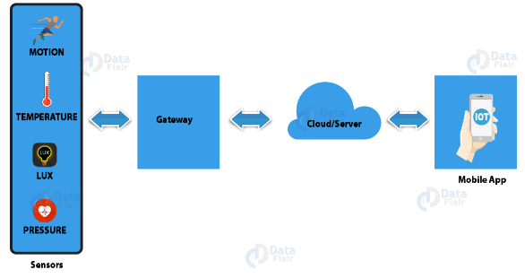
How IoT works?
IoT devices share the sensor data they collect by connecting to an IoT gateway or another edge device where data is either sent to the cloud to be analyzed or analyzed locally.
Notes:
What do we call local analysis?
Edge computing, or fog computing.

Slide 30
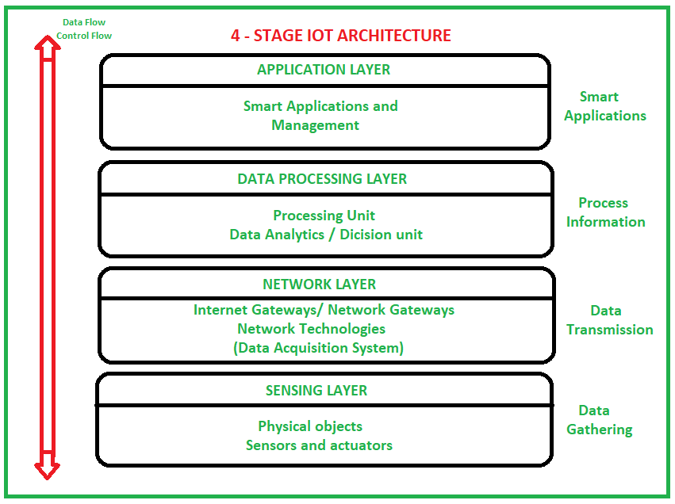
Notes:
[Q] Can you identify (pinpoint) directions of dataflow and control flow.
Control direction is top down, while dataflow is bottom up.
Bottom – Up : Collect → Communicate → Process (Analyze) → Act (Decide what to do)

Slide 32
Notes:
Model: Abstraction of complex reality.

Slide 33
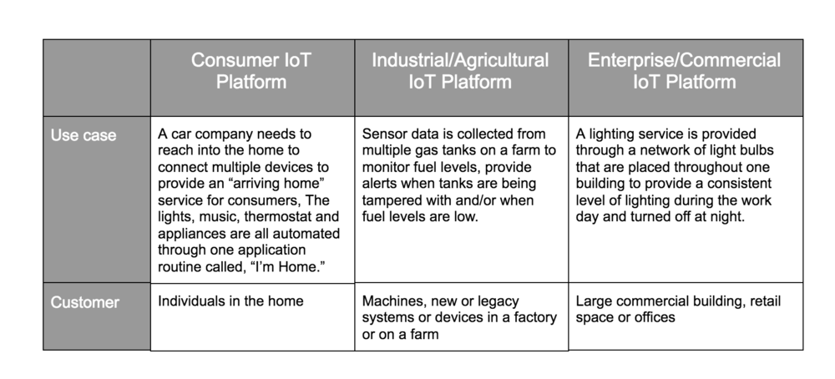
Devices and Networks
consumer, enterprise, and industrial IoT
Applications and use cases
Notes:
IoT devices are meant to work in concert for people at home, in industry or in the enterprise.
As such, the devices can be categorized into three main groups: consumer, enterprise and industrial. Page 72 of module.
This discussion is about IoT device categorization and their case of use.
Then the discussion about Network & Device Management Platform for IoT will follow.
Enterprise: A Business or Company.
Industry: a particular form or branch of economic or commercial activity.
Consumer: Individual users, Individual customers for personal use.

Slide 34
IoT Tools & Platforms
There are many vendors in the industrial IoT platform marketplace, offering remarkably similar capabilities and methods of deployment.
IoT Platform | Key Features (Services)
KAA | Manage an unlimited number of connected devices Set up cross-device interoperability Perform real-time device monitoring Perform remote device provisioning and configuration Collect and analyze sensor data Analyze user behavior and deliver targeted notifications Create cloud services for smart products
Notes:
These IoT Platform Solutions are based on the Internet of Things and cloud technology.
They can be used in areas of smart home, city, enterprise, home automation, healthcare or automotive industry, just to name a few.
Kaa is a 100% open-source middleware platform for developing and managing complete end-to-end IoT solutions, connected applications, and smart products. Kaa provides a feature-rich toolkit for IoT product development and dramatically reduces associated costs, risks, and time-to-market.
As said many times, tools and platforms make life of developers (software engineers) much easier.

Slide 35
IoT Tools & Platforms
The most important services offered by an IoT cloud platform are application development, device management, system management, heterogeneity management, data management, tools for analysis, deployment, monitoring, visualization, and research.
All the computing resources offered by an IoT Platform can be rapidly provisioned and released with minimal management effort or service provider interaction.

Slide 36
IoT Tools & Platforms
Briefly discuss the IoT development tools listed below.
(Activity 4.8, page 76 of module).
Tessel 2 Eclipse IoT Arduino PlatforIO IBM Watson | Raspbian OpenSCADA Node-RED Kimono Create Device Hive
Notes:
This is left as a reading assignment for you to investigate and get idea about each of them.
It is taken from page 76 of MOSHE module, Activity 4.8

Slide 37
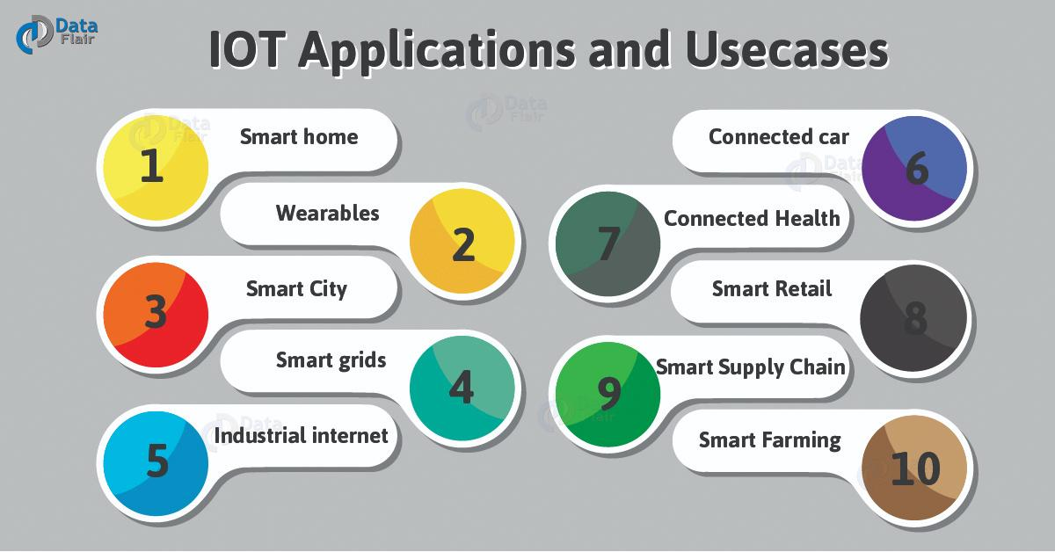
Applications of IoT
Notes:
For more information and examples, read the module.
You can categorize them into the three main groups mentioned earlier: consumer, enterprise, and industrial.

Slide 38
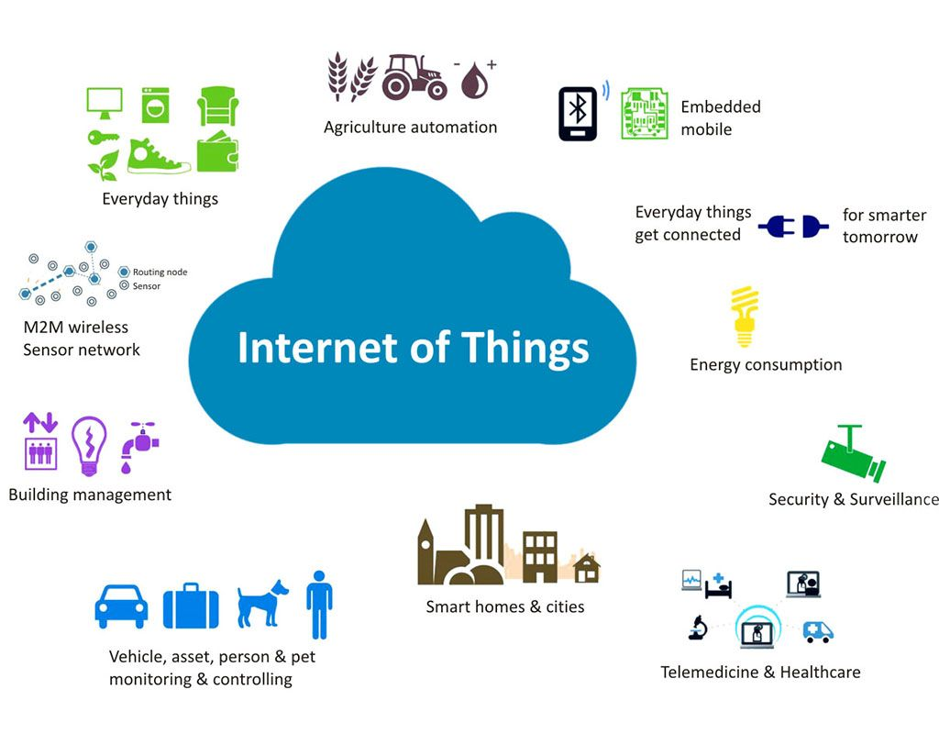
Applications of IoT
Notes:
For detailed information and more examples, read module.

Slide 39
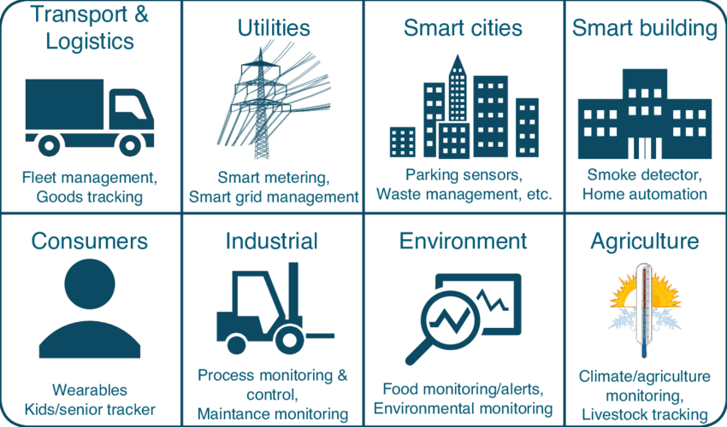
Applications of IoT
Notes:
For more information and examples, read module.

